Slide 1
CASE STUDIES IN
OPERATING SYSTEMS

Slide 2
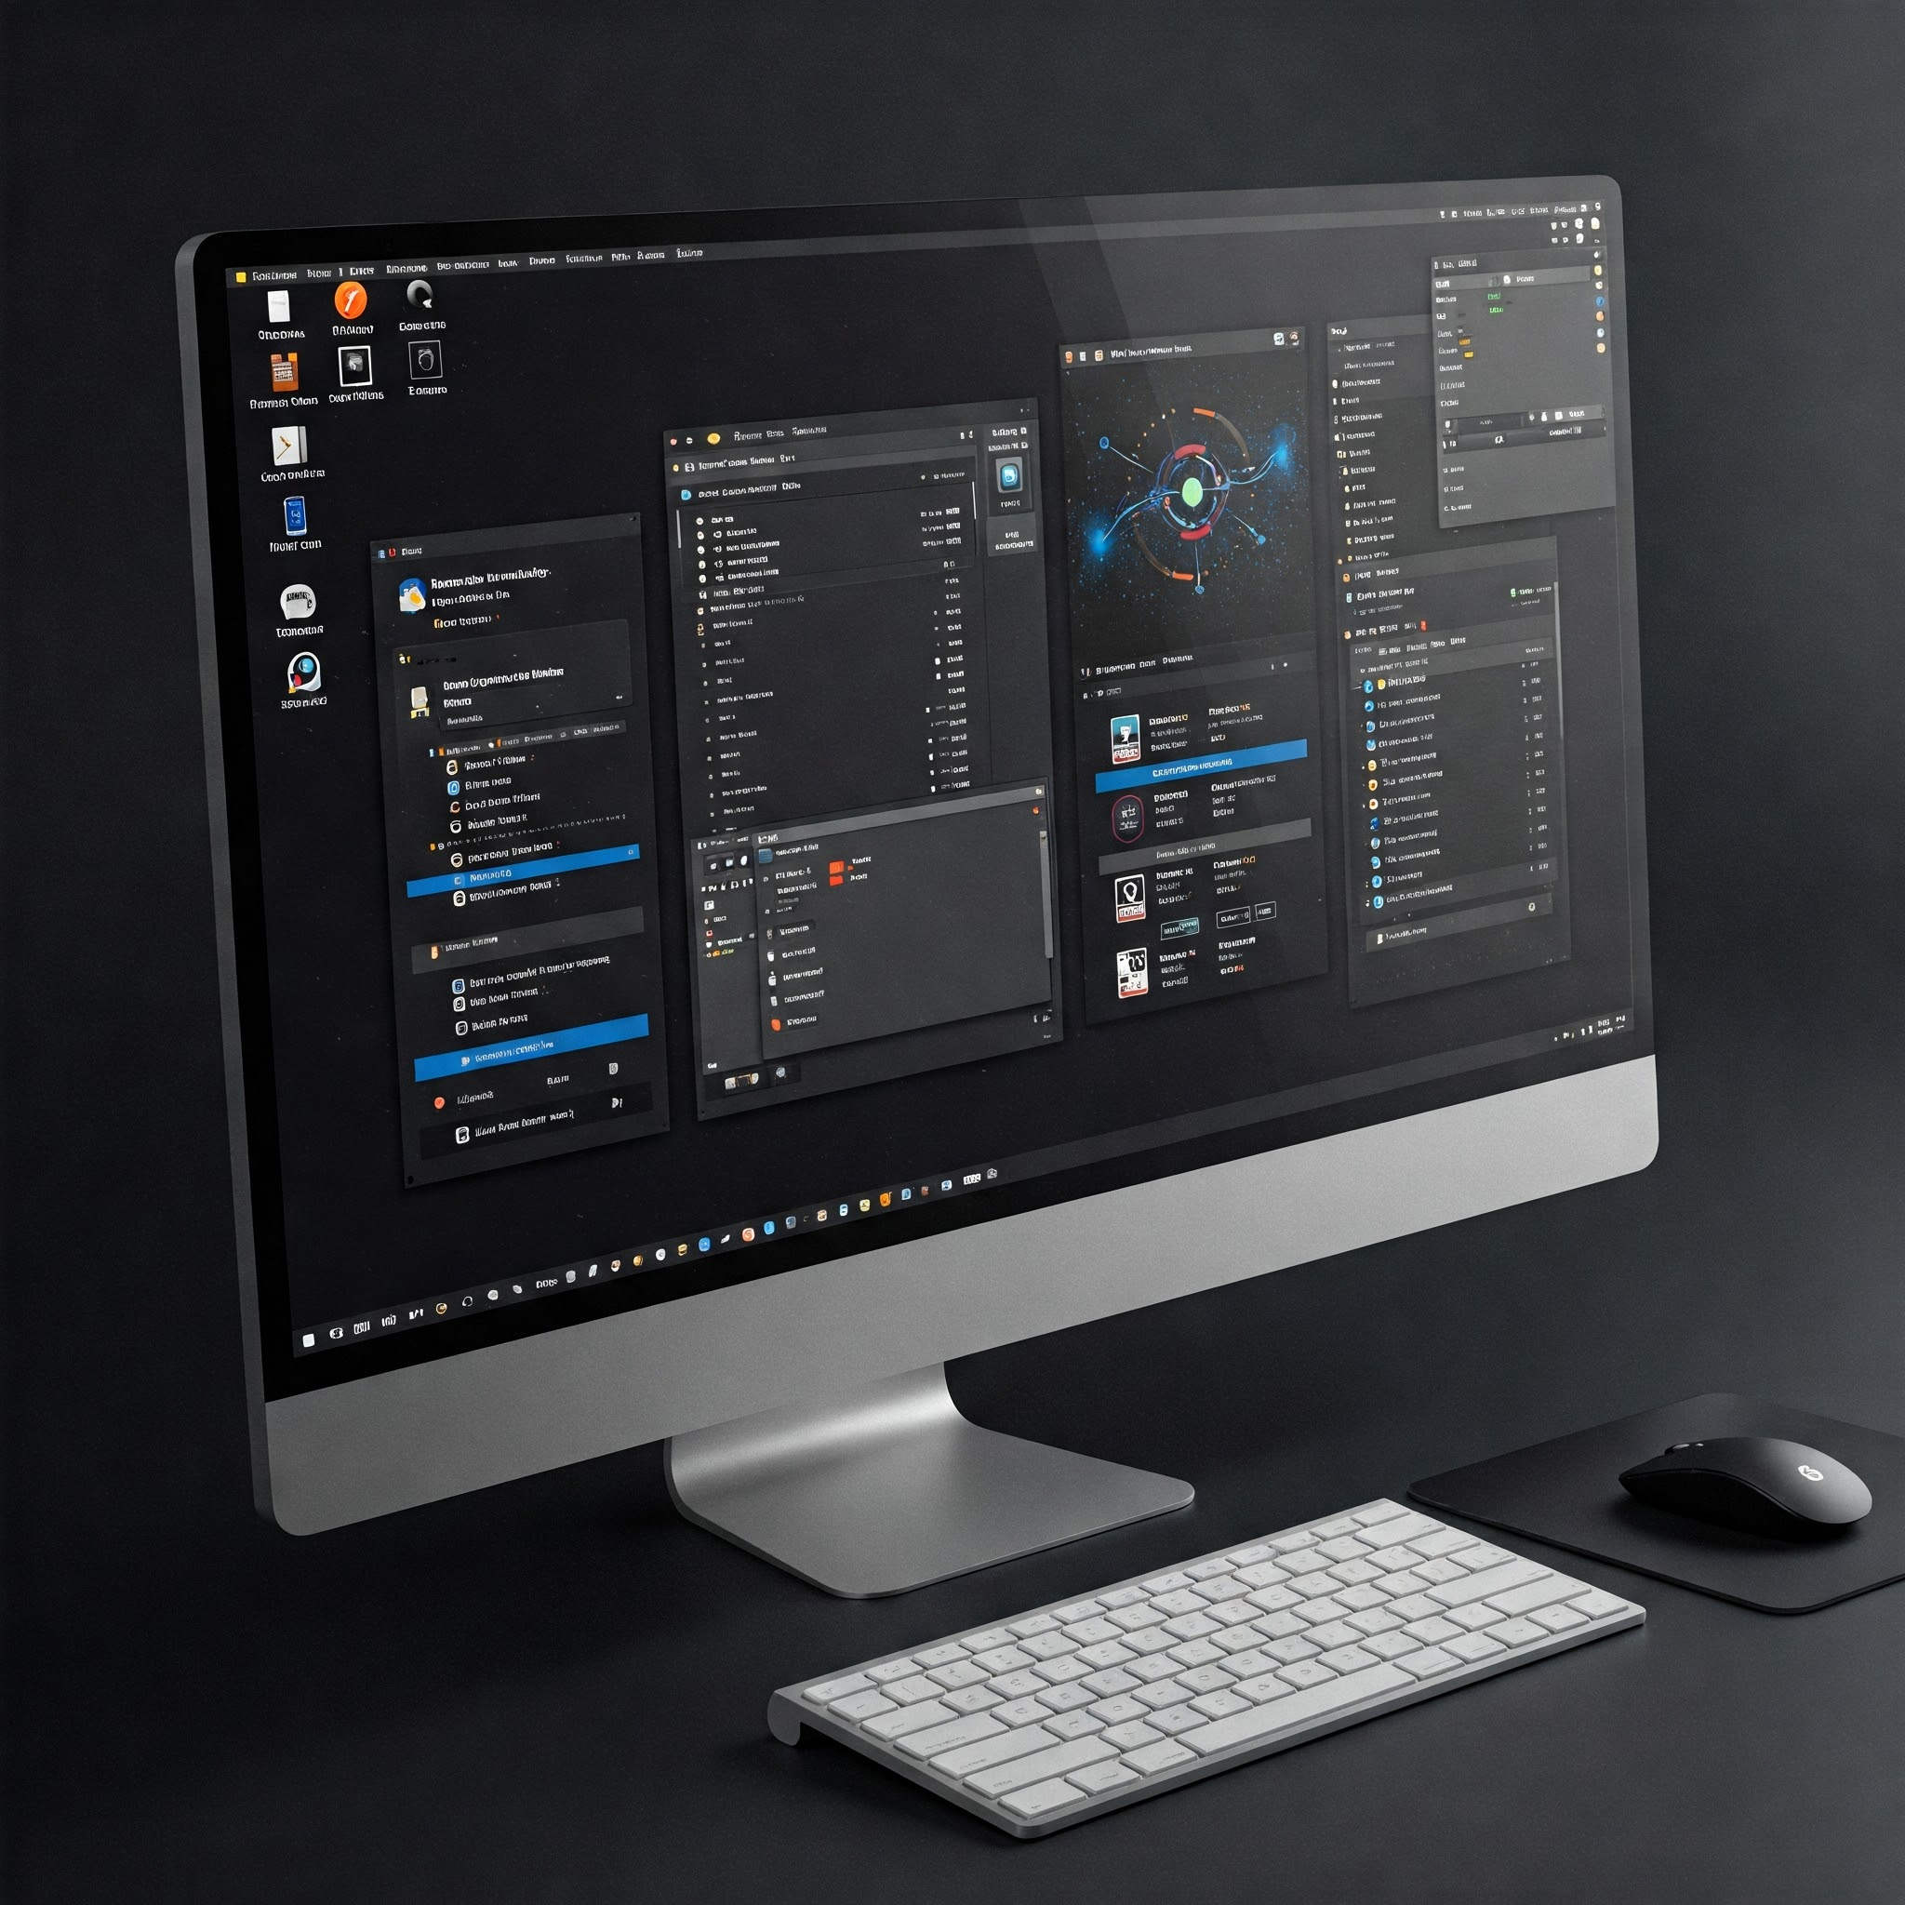
GROUP MEMBERS
NAME : ARAFAT MD SHAHARIAR
S.ID : 202322240346
NAME : SOUROV SADIK
S.ID : 202322240304

Slide 3
INTRODUCTION TO CASE STUDIES

Slide 4
What are OS Case Studies?
An OS case study is a detailed analysis of an operating system, focusing on its architecture, features, real-world applications, and impact. It typically focuses on technical aspects (e.g., architecture, scheduling, memory management) and practical outcomes (e.g., use cases, performance, security)
OS case studies aim to learn from real-world incidents and improve security practices

Slide 5
For security: They study how hackers find and use weaknesses, how the system fights back, and what could have stopped the attack. They might focus on one flaw, a single attack, or a full security breach.
Benefits of operating systems case studies:
OS case studies help students learn OS design, guide developers in building better apps, assist organizations in choosing the right OS, and inform research on system improvements and trends.
There are some key-point of operating systems case studies benefits.
Enhanced Understanding
Critical Thinking and Problem-Solving
Practical Application
Real-World Context
Collaboration and Teamwork
Improved Decision-Making
Identifying Critical Factors
Developing Communication Skills

Slide 6
importance of understanding practical implementations
Understanding practical implementations in operating systems (OS) is crucial for various reasons, including improving application development, enhancing system performance, and enabling effective troubleshooting and optimization. It also provides a foundation for understanding more advanced concepts like virtualization, cloud computing, and network security. It allows you to communicate with the computer without knowing how to speak the computer's language. Without an operating system, a computer is useless.

Slide 7
OS case studies make it easier to understand how operating systems work in real life, connecting textbook ideas to actual problems.
How different operating systems solve common challenges: For instance, how do Linux, Windows, and macOS manage memory, and what are the pros and cons of each approach?
The rationale behind design choices: Why did the developers of a particular OS choose a specific scheduling algorithm or file system structure?
The trade-offs between competing goals: How do OS designers balance performance, security, and user-friendliness?
The evolution of operating systems: How have operating systems adapted to changing hardware, software, and user needs over time?

Slide 8
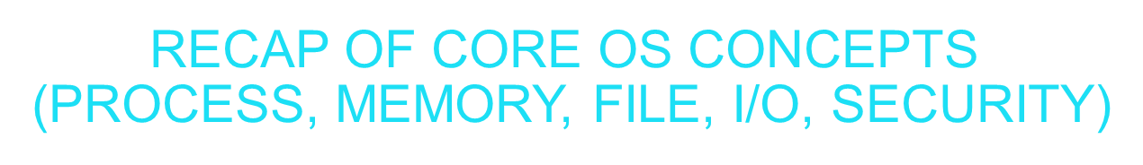
Memory
Definition: Manages allocation and access to system memory for processes.
Key Aspects: Memory Hierarchy: Registers, Cache, RAM, Virtual Memory, Disk. Memory Management: Paging, Segmentation, Demand Paging. Virtual Memory: Maps logical addresses to physical addresses, enabling larger program sizes. Memory Allocation: First-Fit, Best-Fit, Worst-Fit.
File
DEFINITION: LOGICAL STORAGE UNIT FOR DATA, ORGANIZED IN A FILE SYSTEM.
KEY ASPECTS: FILE SYSTEMS: NTFS, FAT32, EXT4 FOR ORGANIZING AND ACCESSING FILES.
FILE OPERATIONS: CREATE, READ, WRITE, DELETE, APPEND.
DIRECTORY STRUCTURE: HIERARCHICAL ORGANIZATION (E.G., FOLDERS, SUBFOLDERS).
FILE METADATA: ATTRIBUTES LIKE SIZE, PERMISSIONS, AND TIMESTAMPS. ACCESS METHODS: SEQUENTIAL, DIRECT, INDEXED.

Slide 9
I/O (Input/Output)
HANDLES OS-DEVICE COMMUNICATION VIA:
DEVICE TYPES: BLOCK (DISKS), CHARACTER (KEYBOARDS)
METHODS: PROGRAMMED I/O, INTERRUPT-DRIVEN, DMA
TECHNIQUES: BUFFERING, SPOOLING
DRIVERS: HARDWARE-OS INTERFACE
Security
Definition: Protects system resources and data from unauthorized access.
Authentication: Verifies user identity ( passwords, biometrics ).Authorization: Defines access permissions (e.g., read, write, execute).
Cryptography: Encrypts data for confidentiality and integrity. Access Control: Models like DAC (Discretionary), MAC (Mandatory), RBAC (Role-Based).
Threats & Countermeasures: Malware, phishing, firewalls, intrusion detection systems.

Slide 10
UNIX/Linux

Slide 11
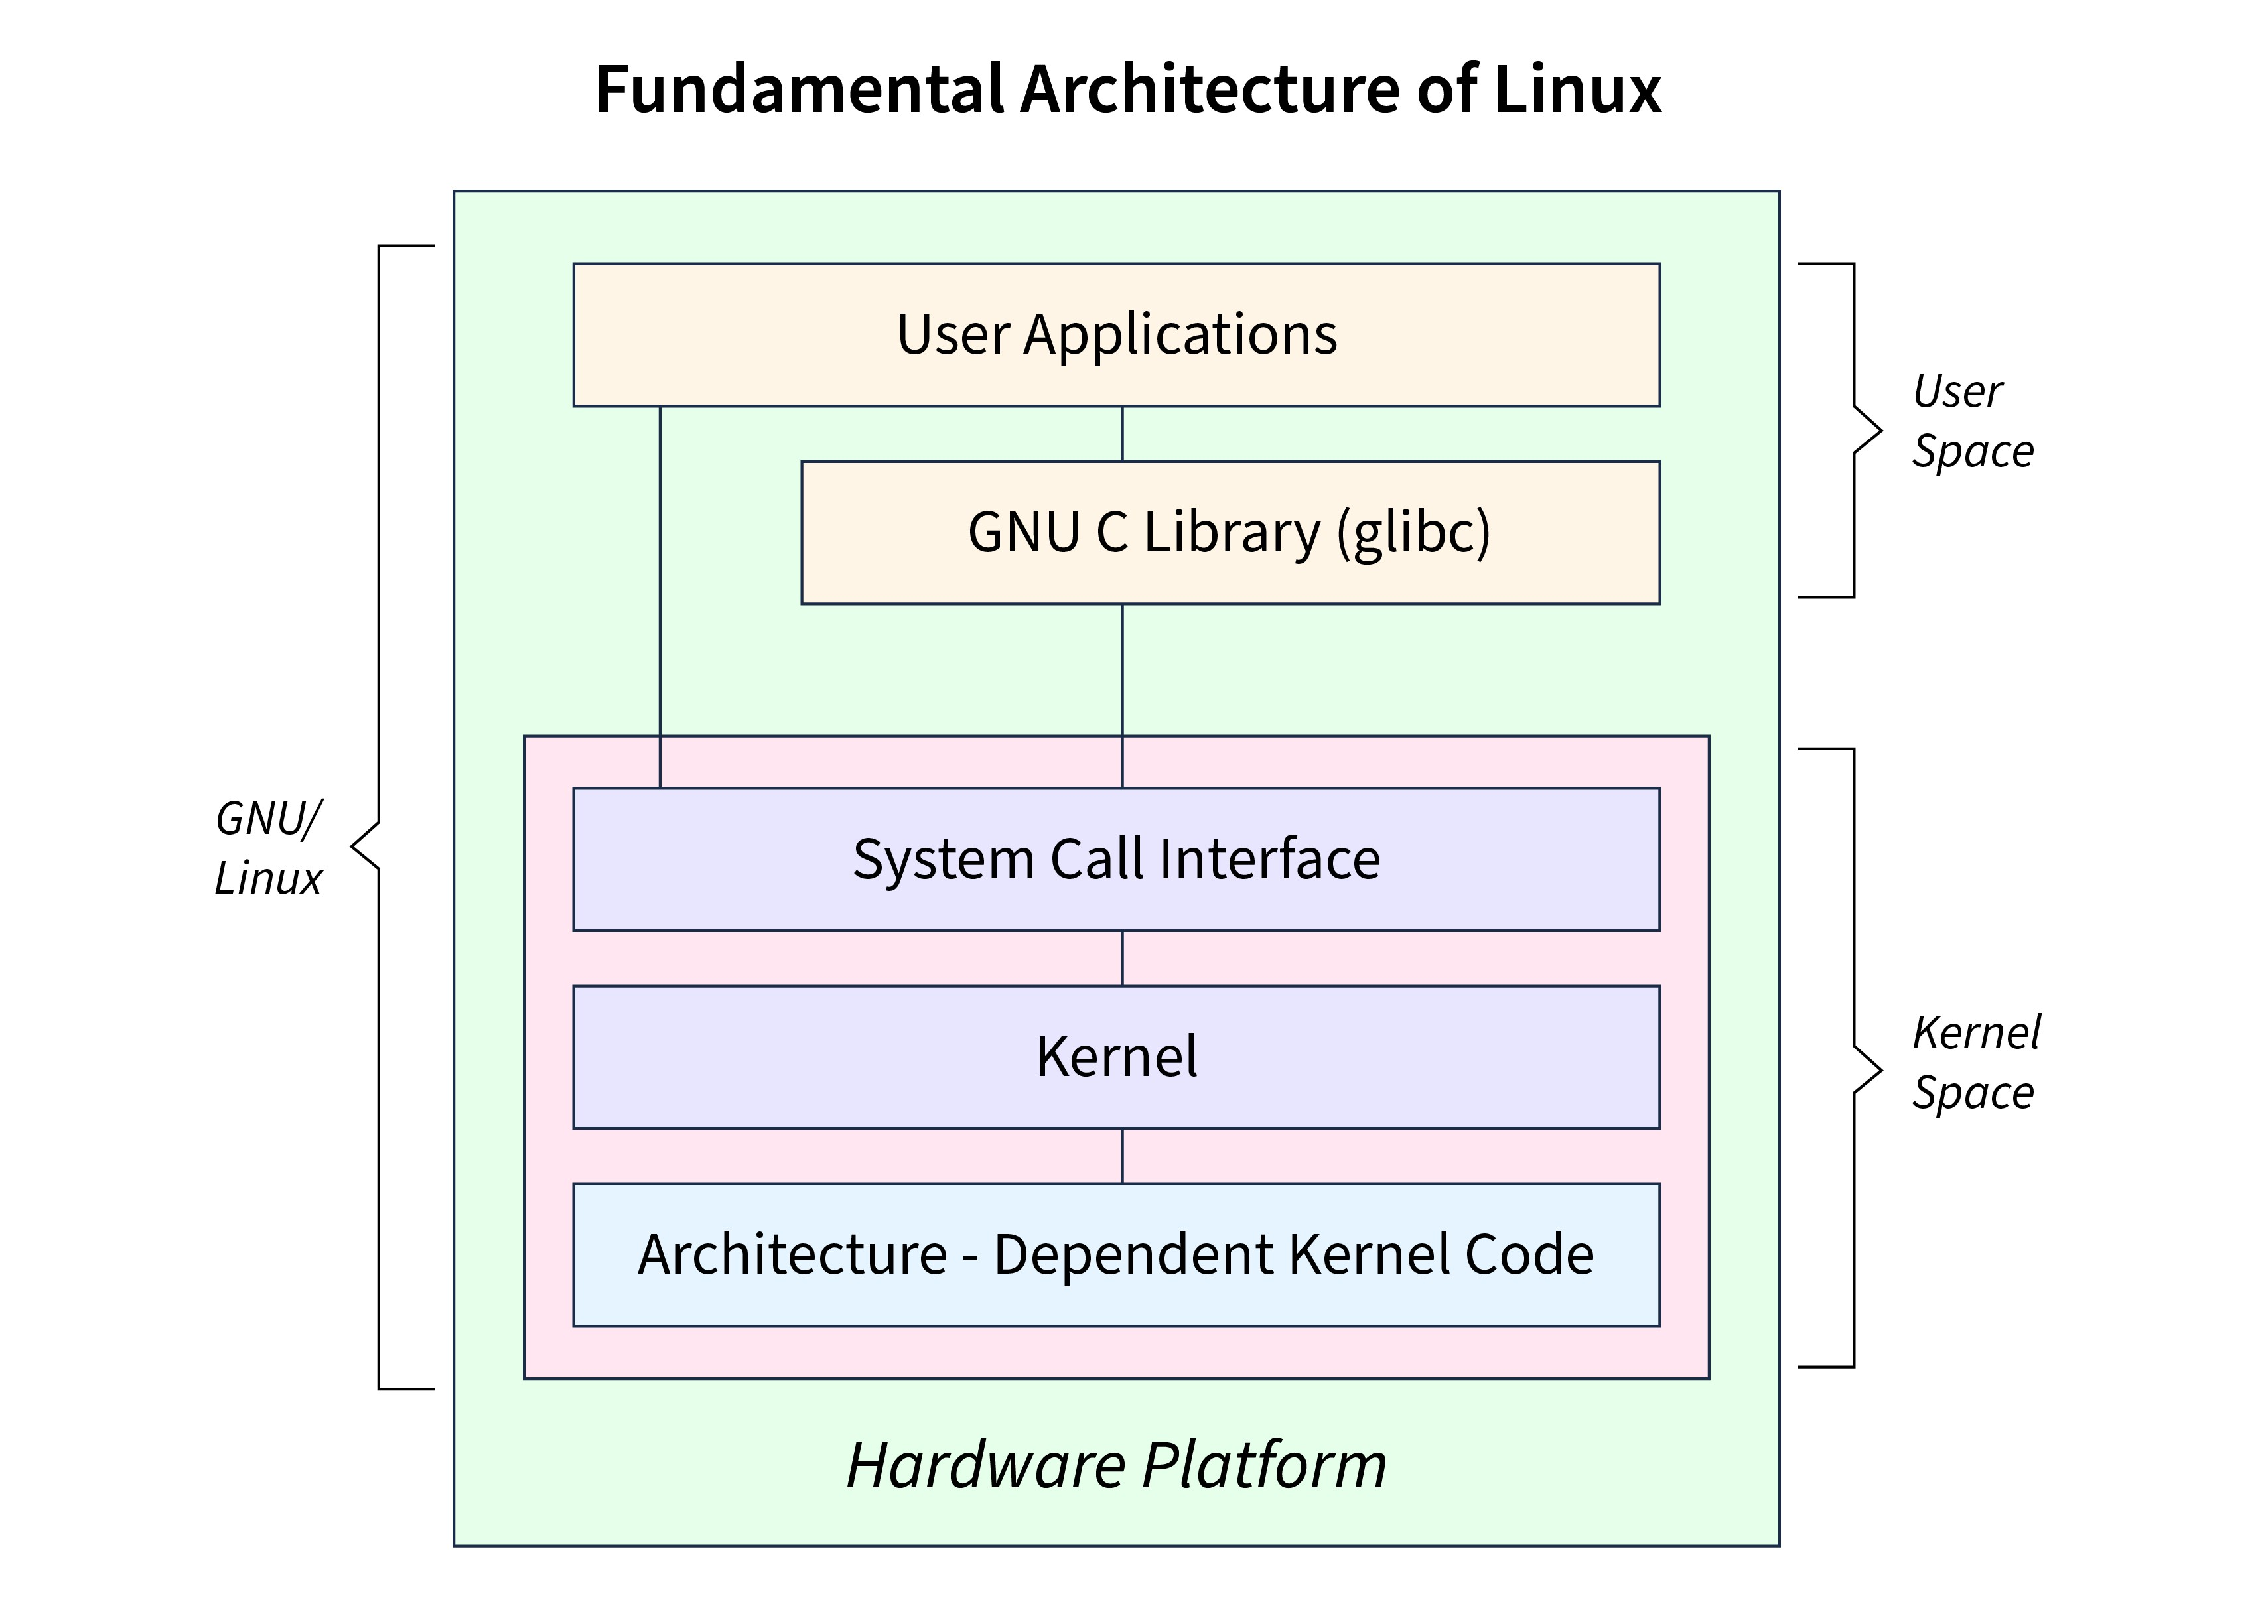
Case Study: UNIX/Linux
A UNIX/Linux case study is a detailed look at how the UNIX or Linux operating system works, exploring its structure and key parts. It shows how Linux handles things like running programs (processes), managing memory, storing files (e.g., Ext4), and keeping the system secure (e.g., user permissions, SELinux). Using simple examples, it explains how these features are built, how they work in real life, and why they matter in a popular, reliable OS.

Slide 12
LINUX SYSTEM ARCHITECTURE
Overview: Linux is a monolithic kernel-based OS, meaning the kernel handles core functions (process management, memory, I/O, file systems) in a single address space, but it supports modular components (loadable kernel modules).
Components:
User space: applications, libraries, and system utilities (e.g., gcc) run here, interacting with the kernel via system calls.
Memory management: virtual memory and page allocation.
File systems: manage storage [e.g., Ext4(Fourth Extended Filesystem), XFS(Extents File System)].
Networking: TCP/IP(Transmission Control Protocol/Internet Protocol) stack and network protocols.
Modularity: loadable kernel modules (e.g., Drivers) allow dynamic extension without rebooting.
.

Slide 13
Process and Thread Handling
Processes:
Linux represents processes as tasks, each with a unique Process ID (PID) and a Task Structure (similar to PCB(Process Control Block)) storing state, priority, and memory info.
Creation: fork() creates a child process by duplicating the parent; exec() loads a new program into the process.
States: processes transition between states (e.g., Running, waiting) managed by the kernel.
Scheduling: the completely fair scheduler (CFS (Completely Fair Scheduler)) assigns CPU time based on process priority and fairness, using a red-black tree to track tasks.
Threads:
Linux implements threads as lightweight processes (LWPS) sharing the same memory space, file descriptors, and other resources.
Created using clone() system call, which allows fine-grained control over shared resources. Managed via the POSIX threads (threads) library in user space. Inter-process communication (IPC):
Mechanisms include pipes, message queues, semaphores, shared memory, and sockets. Signals (e.g., SIGTERM) handle process control and communication.
Example: A web server (e.g., Apache) spawns multiple threads to handle concurrent client requests, sharing memory for efficiency.

Slide 14
Virtual Memory Management
Overview: Linux uses virtual memory to provide each process with an isolated address space, mapping virtual addresses to physical memory or disk.
Key mechanisms:
Paging: Splits memory into fixed 4KB pages, mapped via page tables.
Demand Paging: Loads pages only when accessed (saves RAM).
Swap: Disk backup for full RAM.
Address space layout:
Example: A process running a large database query may trigger page faults, prompting the kernel to load data from swap or disk transparently.

Slide 15
File System Structure (ext4)
The file system structure in Linux organizes how data is stored, accessed, and managed on disk.
KEY FEATURES:
JOURNALING (CRASH RECOVERY)
EXTENTS (EFFICIENT LARGE FILES)
HIERARCHICAL DIRECTORIES (E.G., /HOME, /VAR)
STRUCTURE:
SUPERBLOCK (METADATA) Backup copies protect against failure
INODES (FILE INFO) Contains all file metadata (permissions, owner, timestamps)
BLOCK GROUPS (Improves performance and reduces fragmentation)

Slide 16
Security Model (User Permissions, SELinux)
Linux secures resources using a combination of:
1. User Permissions (DAC - Discretionary Access Control)
Traditional method based on user/group ownership and permissions (read, write, execute).
Example: A file owned by "user1" with read permissions can be read by "user1".
2. SELinux (MAC - Mandatory Access Control)
Adds a layer of security on top of DAC.
Controls access based on security policies, regardless of user/group.
Example: Even if "user1" owns a file, SELinux can prevent a specific process run by "user1" from accessing it.

Slide 17
Microsoft Windows

Slide 18
Case Study: Microsoft Windows
Defination:
A case study is an in-depth analysis of a specific subject, often used to explore real-world applications, challenges, and outcomes in a particular context. In the context of Microsoft windows, a case study would involve examining the development, deployment, impact, or specific use of the windows operating system in a detailed manner, often focusing on a particular scenario, organization, or time period.
Overview:
A case study is a detailed story that examines how something, like the Microsoft Windows operating system, is used in a real-world situation. It explores how Windows is set up, what it does, any problems that arise, and what’s learned, focusing on a specific scenario, organization, or time period. Below, I’ll explain what a Windows case study is in simple terms, provide an overview of its key elements, and include a brief example, ensuring it aligns with your request for an easy explanation. I’ll also connect it to your prior Linux case study queries (e.g., security model, database query) by drawing parallels where relevant.

Slide 19
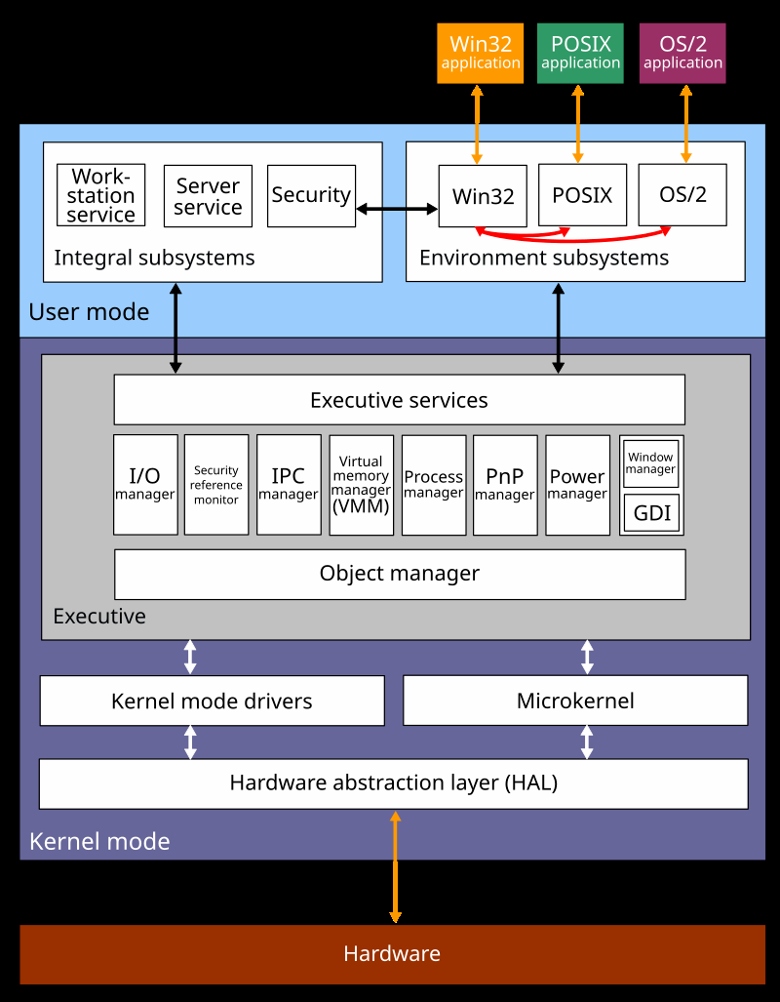
Windows Architecture
Microsoft windows operates on a hybrid kernel architecture, combining elements of microkernel(SLOW BUT SAFE) and monolithic kernel(fast but risky if something crashes) designs for performance and modularity. Key components include:

Slide 20
Windows ArchitecturE
Microsoft windows operates on a hybrid kernel architecture, combining elements of microkernel(slow but safe) and monolithic kernel(fast but risky if something crashes) designs for performance and modularity. Key components include:
Kernel mode:
Executive services: manage core OS functions like memory, process, and I/O.
Kernel: handles low-level tasks such as thread scheduling, interrupt handling, and hardware abstraction.
Device drivers: interface with hardware, abstracted through the windows driver model (WDM).
Hardware abstraction layer (HAL): ensures portability across different hardware platforms.
User mode:
Environment Subsystems:
Translate app commands for the OS.
Example: The Win32 subsystem lets you run classic Windows apps like Calculator.

Slide 21
Thread Scheduling and Process Management
Windows employs a preemptive multitasking model for efficient thread scheduling and process management:
Processes: each process is an independent execution unit with its own memory space. Processes contain one or more threads.
Threads: the smallest schedulable unit, sharing the parent process’s resources. Windows uses a priority-based scheduling algorithm:
Dispatcher: the kernel component that assigns threads to CPU cores, using a round-robin approach for equal-priority threads.
Multicore support: windows leverages symmetric multiprocessing (SMP) to distribute threads across multiple cores, optimizing performance.
Context switching: efficient switching between threads minimizes overhead, with mechanisms like the kernel transaction manager ensuring atomic operations.
This design ensures responsive performance, even under heavy workloads, making windows suitable for both consumer and enterprise applications

Slide 22
Memory Management Strategies
Key Strategies:
Virtual Memory (Paging)
Uses disk space as "extra RAM" when physical memory is full
Example: When you open 50 Chrome tabs, Windows moves inactive pages to pagefile.sys
Dynamic Memory Allocation
Gives apps memory when needed, takes back when closed
Real-World Impact:
A hospital's patient records system:
Uses virtual memory to handle 1000+ records
Prioritizes active patient data in physical RAM
Compresses background admin tools' memory
Prevents one crashing app from corrupting others' memory

Slide 23
NTFS File System Features
File Compression:
Transparently saves disk space
Example: Compresses old project files (e.g., 5GB → 3GB) while remaining accessible
Journaling: Prevents data corruption during crashes
Example: Power outage during save operation → Windows recovers unsaved Word doc
Large File Support:
Handles files up to 16TB
Example: 4K video editors work with huge raw footage files
Disk Quotas:
Limits user storage space
Example: University sets 50GB limits per student account.

Slide 24
Security Features
Windows
Key Security Features with Examples:
User Account Control (UAC):
What it does: Asks for admin approval before system changes
Example: Blocking a suspicious program from installing without permission
Windows Defender (Antivirus + Firewall):
What it does: Real-time malware scanning & network protection
Example: Stopping a ransomware attack from encrypting files
BitLocker Encryption:
What it does: Encrypts entire drives to prevent data theft
Example: Protecting sensitive corporate data on a stolen laptop

Slide 25
Android OS

Slide 26
Android OS
A case study is a detailed examination of a specific subject, event, or phenomenon, often used to analyze real-world applications, challenges, and outcomes in a particular context. In the context of android OS, a case study would involve an in-depth exploration of the android operating system’s development, deployment, impact, or use case, focusing on a specific scenario, organization, or technological aspect.

Slide 27
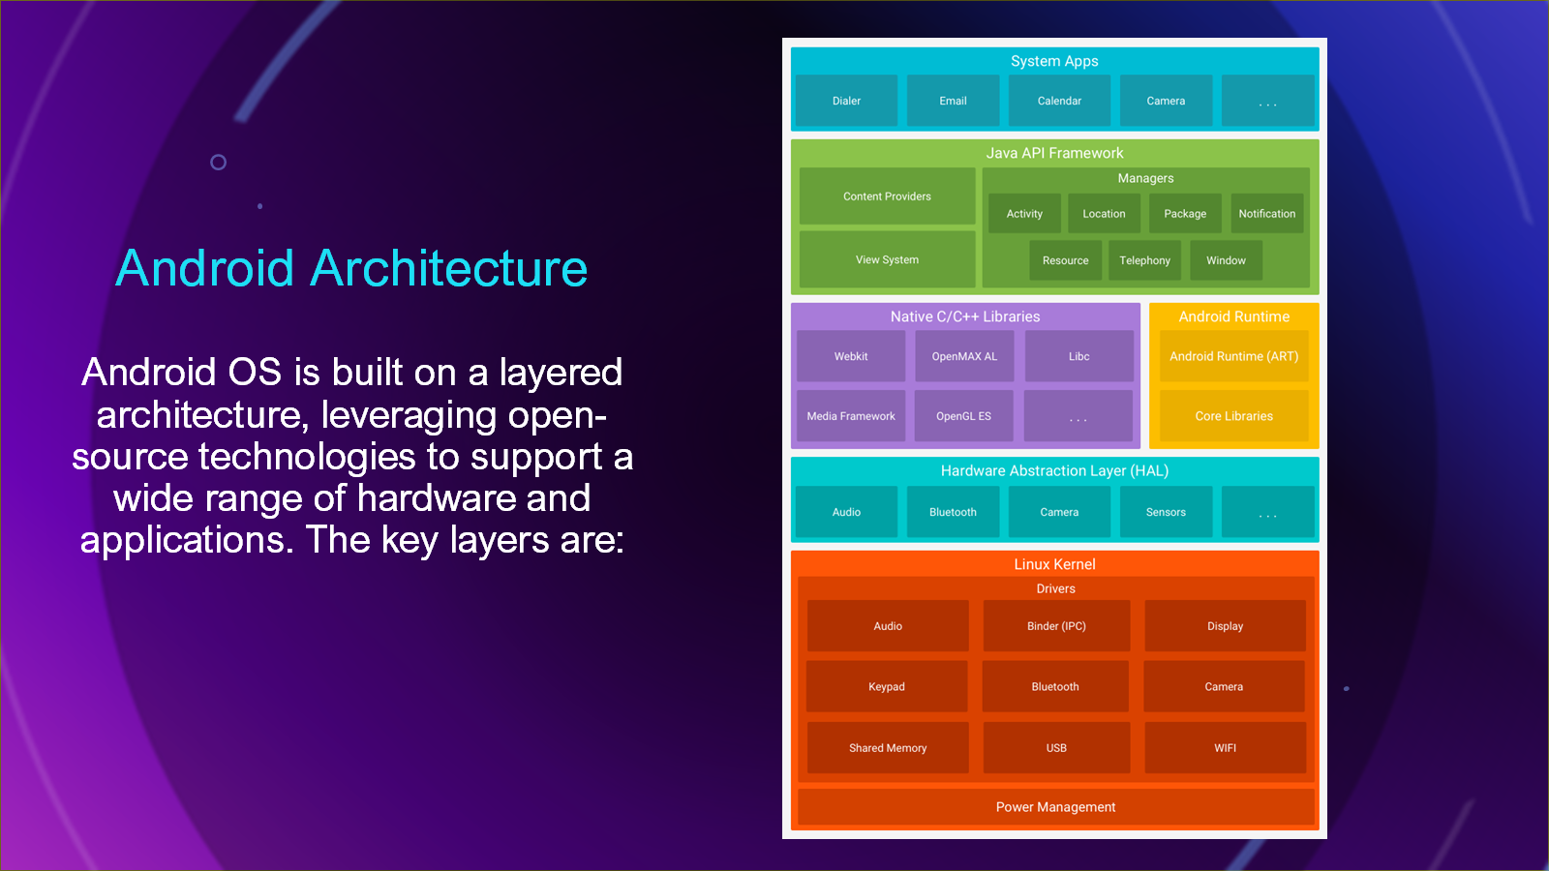

Slide 28
Linux kernel
Linux Kernel (The Brain & Body)
What it does: Manages hardware, memory, and basic functions.
Android Tweaks:
Binder → Helps apps talk to each other securely.
Example: When you tap the screen, the kernel processes the input.
Hardware Abstraction Layer (HAL) (The Translator)
What it does: Lets Android work on different phones (Samsung, Pixel, etc.).
Includes: Camera, Bluetooth, and sensor drivers.
Example: Your Instagram camera works the same on any Android phone.
Native Libraries (The Power Tools)
What they do: Fast, pre-built code for heavy tasks.
Examples:
SQLite → Stores app data (like WhatsApp messages).
OpenGL → Handles graphics in games.

Slide 29
MEMORY MANAGEMENT
Virtual Memory: Each app runs in a separate ART process with its own virtual address space, managed by the Linux kernel.
Garbage Collection: ART’s garbage collector reclaims unused memory, minimizing memory leaks.
Low Memory Killer (LMK):Prioritizes processes (e.g., foreground apps over background services) and terminates low-priority ones when memory is scarce.
ZRAM: Compresses memory pages to increase effective RAM capacity, critical for low-end devices.
Storage Management:
Internal Storage: Each app has a private directory for data, inaccessible to other apps.
Storage Access Framework (SAF): Provides a unified API for apps to access files across providers (e.g., Google Drive, local storage).
Adoptable Storage: Allows SD cards to be formatted as internal storage, expanding capacity on low-storage devices.

Slide 30
SECURITY COMPONENTS
Google Play Protect:
Built-in malware scanner that continuously monitors apps on the device and Google Play Store.
Uses machine learning to detect malicious behavior, scanning over 100 billion apps daily.
Provides features like Find My Device and Safe Browsing to protect against phishing.
App Signing:
Requires apps to be digitally signed with a developer’s private key, ensuring authenticity and integrity.
APK Signature Scheme v2/v3: Enhances verification speed and security.
Play App Signing: Google manages app signing keys for Play Store apps, reducing developer risk and enabling seamless updates.

Slide 31
Comparative Analysis of Case Studies

Slide 32
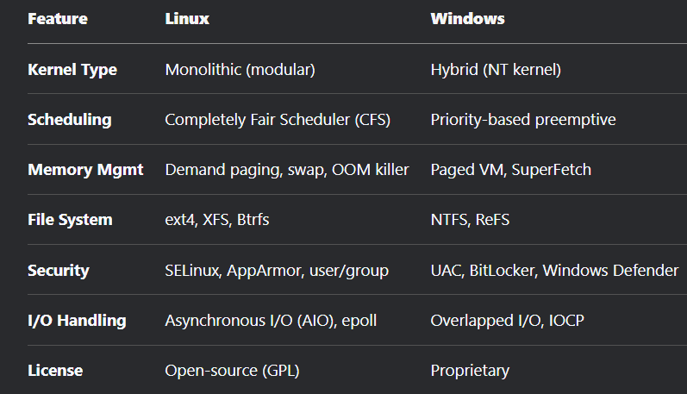
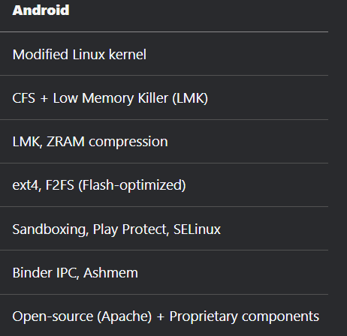
Comparative Analysis of Case Studies.
Side-by-Side Feature Comparison Table

Slide 33
Strengths and Limitations
Linux: ✓ Customizable | ✓ Efficient | ✓ Secure ✗ Hard to learn | ✗ Fragmented
Windows: ✓ User-friendly | ✓ Compatible | ✓ Enterprise-ready ✗ Expensive | ✗ Malware-prone
Android: ✓ Mobile-optimized | ✓ Sandboxed | ✓ Google-integrated ✗ Slow updates | ✗ Privacy issues

Slide 34
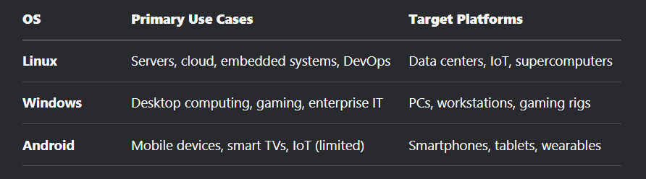
USE CASES AND TARGET PLATFORMS

Slide 35
Conclusion
Windows and android are built for different purposes. Windows’ hybrid kernel, NTFS file system, and strong security make it perfect for powerful computers, servers, and business tasks, but it’s too heavy for low-power devices. Android’s Linux-based system, app security, and features like ZRAM make it great for phones and IOT devices, though device differences can cause issues. Windows excels in enterprise and productivity, while android leads in mobile and embedded tech, each complementing the other’s strengths.

Slide 36
Conclusion and Real-World Relevance of Microsoft Windows and Android OS Comparative Analysis

Slide 37
Conclusion and Real-World Relevance of Microsoft Windows and Android OS Comparative Analysis
Windows and Android are operating systems designed for different purposes. Windows uses a hybrid kernel and NTFS file system, making it great for powerful computers, servers, and complex tasks. It has strong security (like BitLocker) but needs more resources, so it’s not ideal for small, low-power devices. Android, based on a Linux kernel, is optimized for phones and IoT devices. It’s flexible, open-source, and efficient, with features like app sandboxing and ZRAM, but device differences can cause issues. Both systems handle multitasking and security well, but Windows focuses on enterprise needs, while Android prioritizes mobile efficiency.

Slide 38
Practical Impact of OS Design Choices
Windows and Android’s designs impact how they’re used in the real world. Windows’ hybrid kernel and NTFS file system make it scalable for businesses (e.g., managing networks with Active Directory) and creative work (e.g., video editing). Its security features like Windows Defender protect data, but it can be complex for casual users and costly due to licensing. Android’s Linux-based system and open-source nature let it run on affordable smartphones and IoT devices, making tech accessible in developing areas. Its app sandboxing and Google Play Protect keep users safe, but inconsistent updates across devices can leave them vulnerable. Windows focuses on power and features for stable settings, while Android prioritizes flexibility and efficiency for varied, low-power devices. These choices affect user experience, app development, and even cybersecurity strategies.
.

Slide 39
The Importance of Case Studies for Students and Developers
System Design: Understanding how these OSs handle tasks, memory, and security teaches core concepts like managing processes and resources.
Trade-offs: Comparing Windows’ power with Android’s flexibility shows how design choices balance speed, safety, and scalability.
Practical Skills: Learning platform-specific tools (e.g., Win32 for Windows, Android SDK for Android) helps developers build and optimize apps.
Problem-Solving: Real-world issues like Android’s device differences or Windows’ high resource use teach creative solutions.
Career Prep: Knowing these widely used OSs prepares students for jobs in software development, cybersecurity, and IT, where Windows and Android are key players.

Slide 40
Thank you

